Slide 1
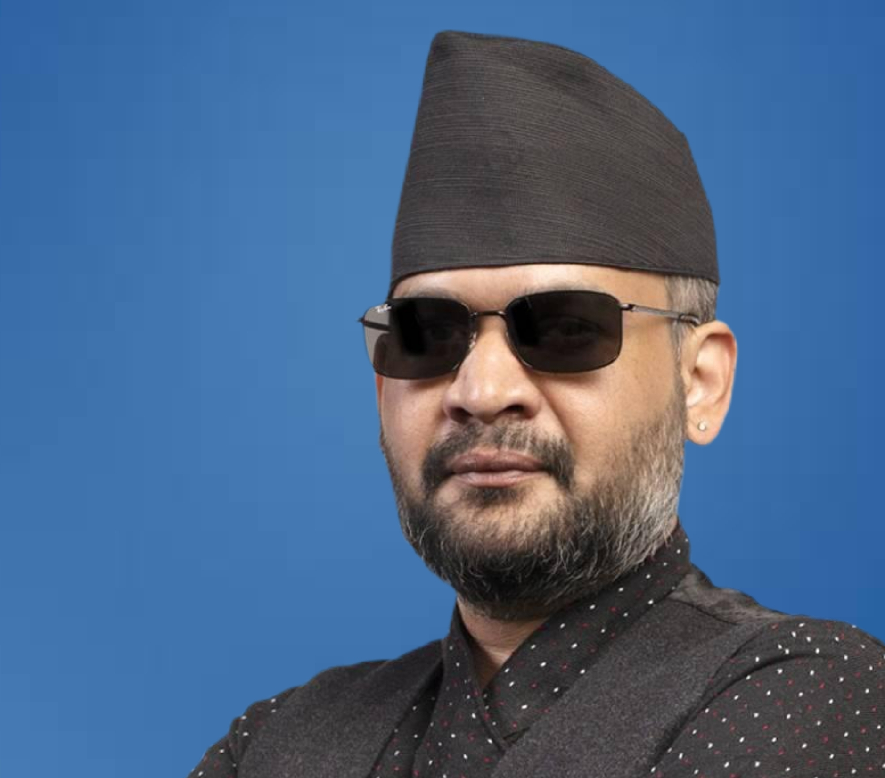
Balendra “Balen” Shah
Leader: Balendra Shah
Nepali rapper, civil engineer, and political leader
Former Mayor of Kathmandu
Known for speaking against corruption and inequality
Inspired young people to participate in politics

Slide 2
Leadership Strength
Strength: Influencing / Activator
Motivates people to take action
Strong communication skills
Uses music and speeches to influence society
Encourages civic engagement

Slide 3
Vision and Leadership
Vision
Transparent government
Reduce corruption
Youth participation in politics
Leadership Impact
Inspired young voters
Encouraged public involvement in government
Represented a new generation of leadership

Slide 4
References
Khurana, S. (2026). Balen Shah: The rapper who is Nepal’s new Prime Minister. The Indian Express.

